Slide 1
Monetary and Fiscal Policy

Slide 2
Introduction
The IS curve represents equilibrium in the goods market. The LM curve represents equilibrium in the money market. The intersection of the two curves determines output and interest rates in the short run, that is, for a given price level.
Expansionary monetary policy moves the LM curve to the right, raising income and lowering interest rates. Contractionary monetary policy moves the LM curve to the left, lowering income and raising interest rates.
Expansionary fiscal policy moves the IS curve to the right, raising both income and interest rates. Contractionary fiscal policy moves the IS curve to the left, lowering both income and interest rates.

Slide 3
IS-LM equillibrium

Slide 4
Monetary Policy
The central bank conducts monetary policy mainly through open market operations. In an open market operation, the central bank buys bonds in exchange for money, thus increasing the stock of money, or it sells bonds in exchange for money paid by the purchasers of the bonds, thus reducing the money stock.
In the case of an open market purchase of bonds, RBI pays for the bonds it buys with money that it can create. The purchase of bonds reduces the quantity of bonds available in the market and thereby tends to increase their price, or lower their yield. That is, only at a lower interest rate will the public be prepared to hold a smaller fraction of its wealth in the form of bonds and a larger fraction in the form of money.

Slide 5
The following figure shows graphically how an open market purchase works. The initial equilibrium at point E is on the initial LM schedule that corresponds to a real money supply, M/P
Now consider an open market purchase by the RBI. This increases the nominal quantity of money and, given the price level, the real quantity of money. As a consequence, the LM schedule will shift to LM’. The new equilibrium will be at point E’ , with a lower interest rate and a higher level of income.
The equilibrium level of income rises because the open market purchase reduces the interest rate and thereby increases investment spending.

Slide 6
Increase in real money stock

Slide 7
If money demand is very sensitive to the interest rate (corresponding to a relatively flat LM curve), a given change in the money stock can be absorbed in the assets markets with only a small change in the interest rate. The effects of an open market purchase on investment spending would then be small.
By contrast, if the demand for money is not very sensitive to the interest rate (corresponding to a relatively steep LM curve), a given change in the money supply will cause a large change in the interest rate and have a big effect on investment demand and thus a larger change in income.

Slide 8
Consider next the process of adjustment to the monetary expansion. At the initial equilibrium point, E, the increase in the money supply creates an excess supply of money to which the public adjusts by trying to buy other assets. In the process, asset prices increase and yields decline. Because money and asset markets adjust rapidly, we move immediately to point E₁, where the money market clears and where the public is willing to hold the larger real quantity of money because the interest rate has declined sufficiently.
At point E₁ , however, there is an excess demand for goods. The decline in the interest rate, given the initial income level Y₀, has raised aggregate demand and is causing inventories to run down. In response, output expands and we start moving up the LM’ schedule.

Slide 9
Increase in real money stock

Slide 10
Because the increase in output raises the demand for money, and the greater demand for money has to be checked by higher interest rates.
Thus, the increase in the money stock first causes interest rates to fall as the public adjusts its portfolio and then—as a result of the decline in interest rates—increases aggregate demand.

Slide 11
The Transmission Mechanism
Two steps in the transmission mechanism —the process by which changes in monetary policy affect aggregate demand—are essential. The first is that an increase in real balances generates a portfolio disequilibrium; that is, at the prevailing interest rate and level of income, people are holding more money than they want.
This causes portfolio holders to attempt to reduce their money holdings by buying other assets, thereby changing asset prices and yields. In other words, the change in the money supply changes interest rates. The second stage of the transmission process occurs when the change in interest rates affects aggregate demand.

Slide 12
There are two critical links between the change in real balances (i.e., the real money stock) and the ultimate effect on income. First, the change in real balances, by bringing about portfolio disequilibrium, must lead to a change in interest rates.
Second, that change in interest rates must change aggregate demand. Through these two linkages, changes in the real money stock affect the level of output in the economy.
But that outcome immediately implies the following: If portfolio imbalances do not lead to significant changes in interest rates, for whatever reason, or if spending does not respond to changes in interest rates, the link between money and output does not exist.

Slide 14
The Liquidity Trap
In discussing the effects of monetary policy on the economy, two extreme cases have received much attention. The first is the liquidity trap , a situation in which the public is prepared, at a given interest rate, to hold whatever amount of money is supplied. This implies that the LM curve is horizontal and that changes in the quantity of money do not shift it.
In that case, monetary policy carried out through open market operations has no effect on either the interest rate or the level of income. In the liquidity trap, monetary policy is powerless to affect the interest rate.
The possibility of a liquidity trap at low interest rates is a notion that grew out of the theories of the great English economist John Maynard Keynes.

Slide 15
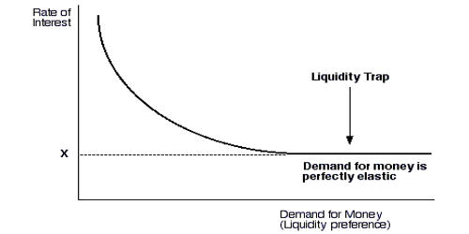

Slide 16
Historically, the liquidity trap has been a useful expositional device mostly for understanding the consequences of a relatively flat LM curve, with little immediate relevance to policymakers.
But there is one situation in which the liquidity trap can be of critical practical concern—that’s when interest rates are so close to zero that they can’t go any lower.

Slide 17
The Japanese case
Once the interest rate hits zero, there is nothing further that a central bank can do with conventional monetary policy to stimulate the economy because monetary policy cannot reduce interest rates any further.
The following figure shows that this is pretty much what happened in Japan in the late 1990s and in the early years of the twenty-first century. Interest rates went from a few percent, down to around .5 percent, and then effectively to zero.
The inability to use conventional monetary policy to stimulate the economy in a liquidity trap had long been mostly important as an illustrative example for textbook writers. But in Japan the zero interest rate liquidity trap became a very real policy issue.

Slide 18
The nominal interest rate has two parts: the real interest rate and expected inflation. As a practical matter, an economy hits a zero interest rate bound when it experiences significant deflation. (Deflation means that prices are dropping or, equivalently, that the inflation rate is negative.) One way for policymakers to avoid the zero interest rate liquidity trap is to pump enough money to keep inflation slightly positive.

Slide 19
Japanese interest rates

Slide 20
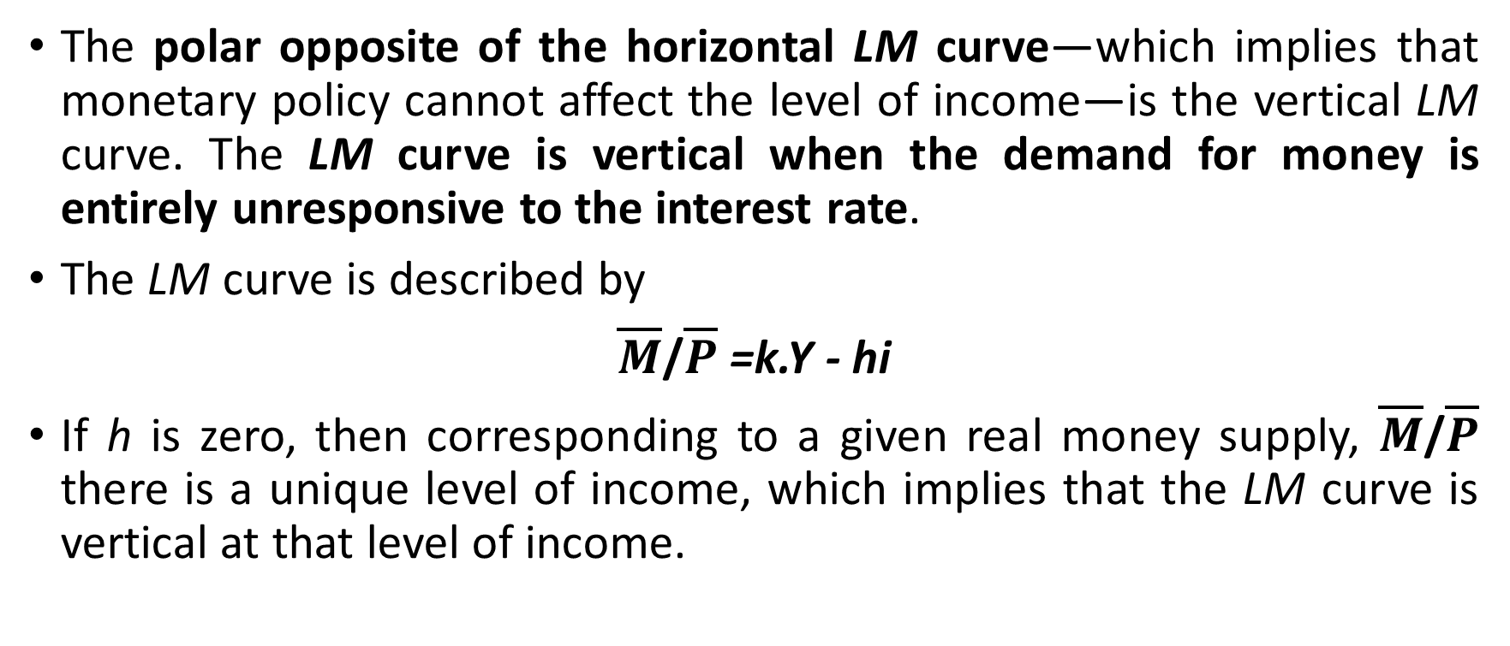
The Classical Case
The polar opposite of the horizontal LM curve—which implies that monetary policy cannot affect the level of income—is the vertical LM curve. The LM curve is vertical when the demand for money is entirely unresponsive to the interest rate.
The LM curve is described by
$\overline{M}$/$\overline{P}$ =k.Y - hi
If h is zero, then corresponding to a given real money supply, $\overline{M}$/$\overline{P}$ there is a unique level of income, which implies that the LM curve is vertical at that level of income.

Slide 21
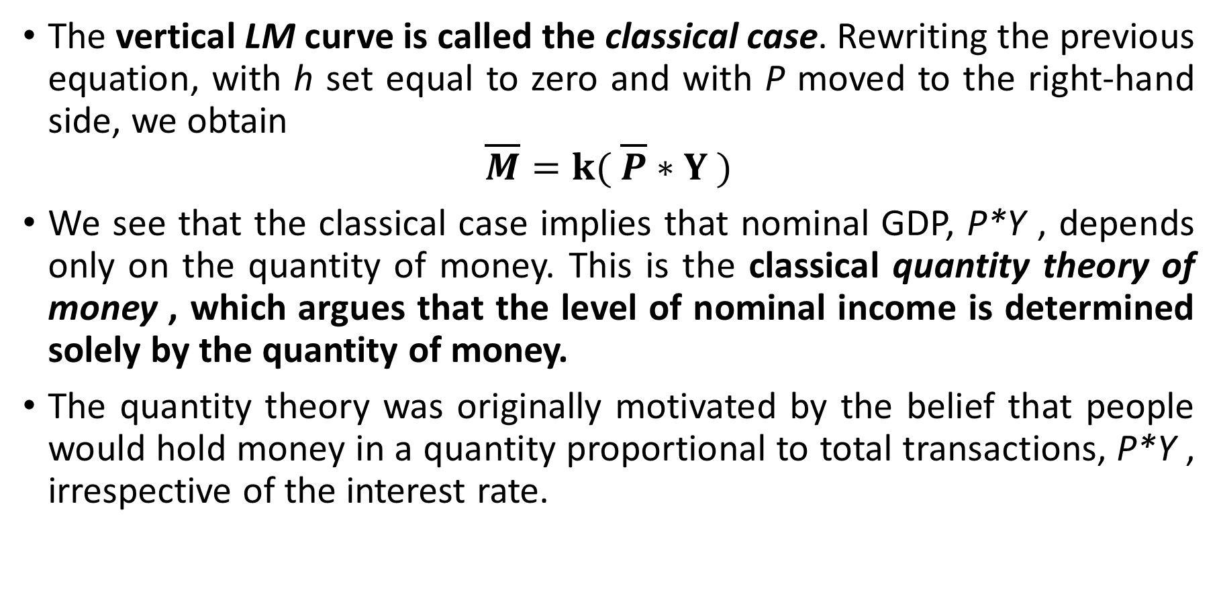
The vertical LM curve is called the classical case. Rewriting the previous equation, with h set equal to zero and with P moved to the right-hand side, we obtain
$$\overline{M}=k( \overline{P}∗Y )$$
We see that the classical case implies that nominal GDP, P*Y , depends only on the quantity of money. This is the classical quantity theory of money , which argues that the level of nominal income is determined solely by the quantity of money.
The quantity theory was originally motivated by the belief that people would hold money in a quantity proportional to total transactions, P*Y , irrespective of the interest rate.

Slide 22
When the LM curve is vertical, a given change in the quantity of money has a maximal effect on the level of income.
You can also see that shifts in the IS curve do not affect the level of income when the LM curve is vertical. Thus, when the LM curve is vertical, monetary policy has a maximal effect on the level of income, and fiscal policy has no effect on income.
The vertical LM curve, implying the comparative effectiveness of monetary over fiscal policy, is sometimes associated with the view that “only money matters” for the determination of output. Since the LM curve is vertical only when the demand for money does not depend on the interest rate, the interest sensitivity of the demand for money turns out to be an important issue in determining the effectiveness of alternative policies.

Slide 23
Fiscal Policy and Crowding Out
The IS curve slopes downward because a decrease in the interest rate increases investment spending, thereby increasing aggregate demand and the level of output at which the goods market is in equilibrium.
Changes in fiscal policy shift the IS curve. Specifically, a fiscal expansion shifts the IS curve to the right. Thus, both government spending and the tax rate affect the IS schedule.
A fiscal expansion raises equilibrium income and the interest rate. At unchanged interest rates, higher levels of government spending increase the level of aggregate demand. To meet the increased demand for goods, output must rise.

Slide 24
The following figure shows the effect of a shift in the IS schedule. At each level of the interest rate, equilibrium income must rise by αG times the increase in government spending. For example, if government spending rises by 100 and the multiplier is 2, equilibrium income must increase by 200 at each level of the interest rate. Thus the IS schedule shifts to the right by 200.
If the economy is initially in equilibrium at point E and government spending rises by 100, we would move to point E’’ if the interest rate stayed constant. At E the goods market is in equilibrium in that planned spending equals output. But the money market is no longer in equilibrium. Income has increased, and therefore the quantity of money demanded is higher.
Because there is an excess demand for real balances, the interest rate rises. Firms’ planned investment spending declines at higher interest rates, and thus aggregate demand falls off.

Slide 25
Effects of increase in G

Slide 26
What is the complete adjustment, taking into account the expansionary effect of higher government spending and the dampening effects of the higher interest rate on private spending?
Only at point E’ do both the goods and money markets clear. Only at point E‘ is planned spending equal to income and, at the same time, the quantity of real balances demanded equal to the given real money stock. Point E’ is therefore the new equilibrium point.

Slide 27
Crowding Out
Comparing E’’ to the initial equilibrium at E, we see that increased government spending raises both income and the interest rate. But another important comparison is between points E’ and E’’ (the equilibrium in the goods market at unchanged interest rates).
In comparing E’ and E’’, it becomes clear that the adjustment of interest rates and their impact on aggregate demand dampen the expansionary effect of increased government spending. Income, instead of increasing to level Y’’ , rises only to Y’₀ .
The reason that income rises only to Y’₀ rather than to Y’’ is that the rise in the interest rate from i₀ to i’ reduces the level of investment spending. We say that the increase in government spending crowds out investment spending. Crowding out occurs when expansionary fiscal policy causes interest rates to rise, thereby reducing private spending, particularly investment.

Slide 28
Income increases more, and interest rates increase less, the flatter the LM schedule.
Income increases less, and interest rates increase less, the flatter the IS schedule.
Income and interest rates increase more the larger the multiplier, α , and thus the larger the horizontal shift of the IS schedule.
In each case the extent of crowding out is greater the more the interest rate increases when government spending rises.
To illustrate these conclusions, we turn to the two extreme cases we discussed in connection with monetary policy, the liquidity trap and the classical case.

Slide 29
The Liquidity Trap
If the economy is in the liquidity trap, and thus the LM curve is horizontal, an increase in government spending has its full multiplier effect on the equilibrium level of income.
There is no change in the interest rate associated with the change in government spending, and thus no investment spending is cut off. There is therefore no dampening of the effects of increased government spending on income.
If the LM curve is horizontal, monetary policy has no impact on the equilibrium of the economy and fiscal policy has a maximal effect. Less dramatically, if the demand for money is very sensitive to the interest rate, and thus the LM curve is almost horizontal, fiscal policy changes have a relatively large effect on output and monetary policy changes have little effect on the equilibrium level of output.

Slide 30
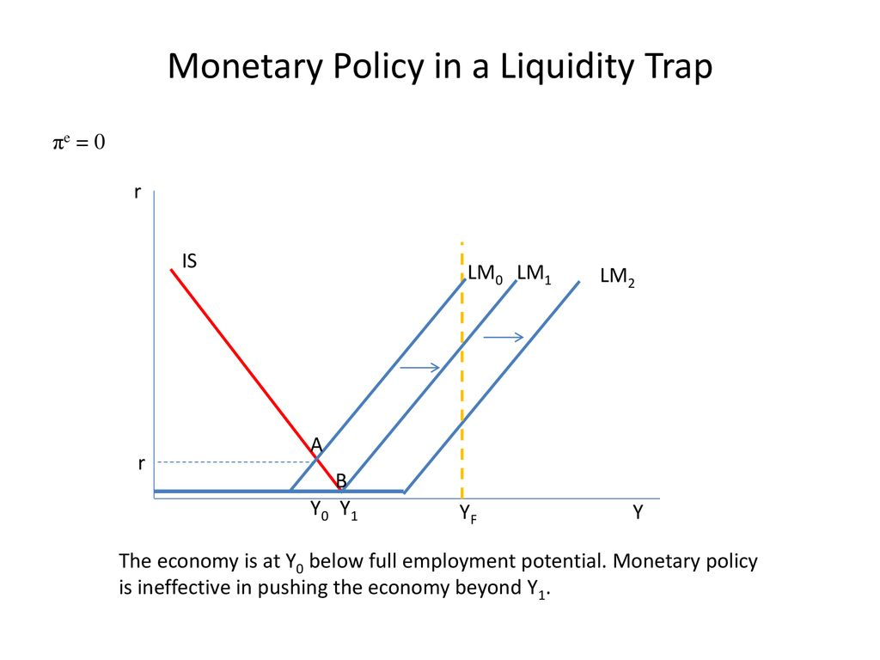

Slide 31
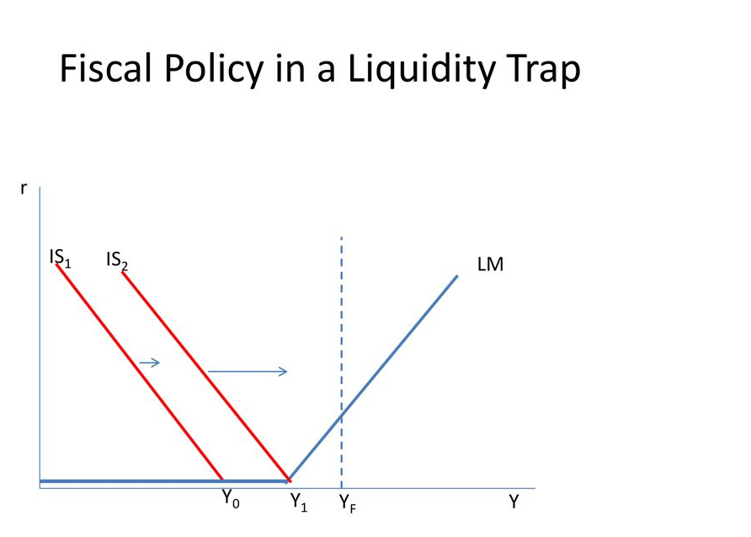

Slide 32
The Classical Case and Crowding Out
If the LM curve is vertical, an increase in government spending has no effect on the equilibrium level of income and increases only the interest rate. If the demand for money is not related to the interest rate, as a vertical LM curve implies, there is a unique level of income at which the money market is in equilibrium.
Thus, with a vertical LM curve, an increase in government spending cannot change the equilibrium level of income and raises only the equilibrium interest rate. But if government spending is higher and output is unchanged, there must be an offsetting reduction in private spending.
In this case, the increase in interest rates crowds out an amount of private (particularly investment) spending equal to the increase in government spending. Thus, there is full crowding out if the LM curve is vertical.

Slide 33
Full Crowding Out

Slide 34
How important is crowding out?
In an economy with unemployed resources there will not be full crowding out because the LM is not, in fact, vertical. A fiscal expansion will raise interest rates, but income will also rise. Crowding out is therefore a matter of degree.
The increase in aggregate demand raises income, and with the rise in income, the level of saving rises. This expansion in saving, in turn, makes it possible to finance a larger budget deficit without completely displacing private spending schedule.
Another point is that with unemployment, and thus a possibility for output to expand, interest rates need not rise at all when government spending rises, and there need not be any crowding out. This is true because the monetary authorities can accommodate the fiscal expansion by an increase in the money supply.

Slide 35
Monetary policy is accommodating when, in the course of a fiscal expansion, the money supply is increased in order to prevent interest rates from increasing. Monetary accommodation is also referred to as monetizing budget deficits , meaning that the RBI prints money to buy the bonds with which the government pays for its deficit.
When the central bank accommodates a fiscal expansion, both the IS and the LM schedules shift to the right. Output will clearly increase, but interest rates need not rise. Accordingly, there need not be any adverse effects on investment.

Slide 36
Policy mix to fight recession

